Slide 1

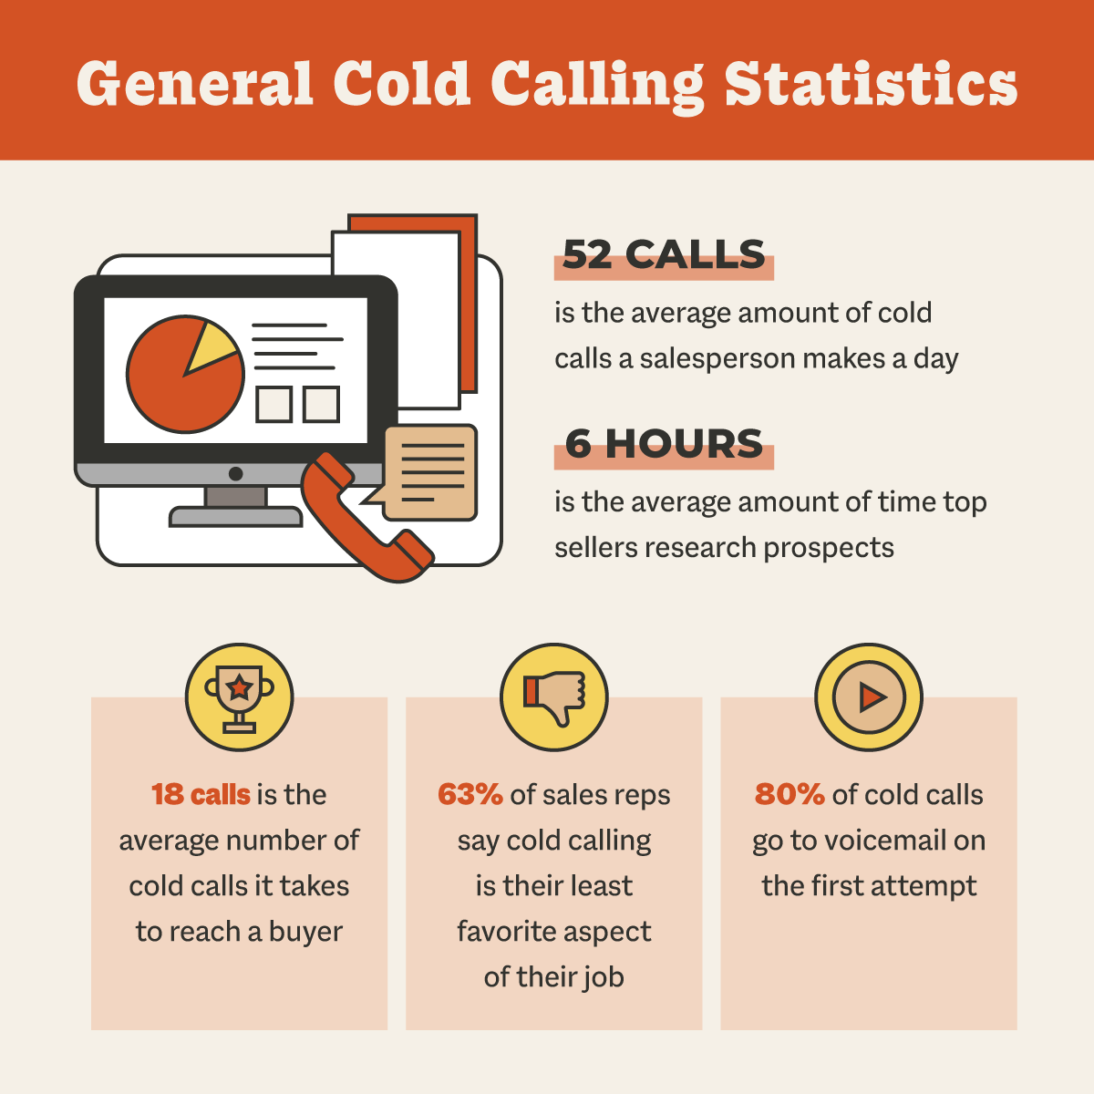
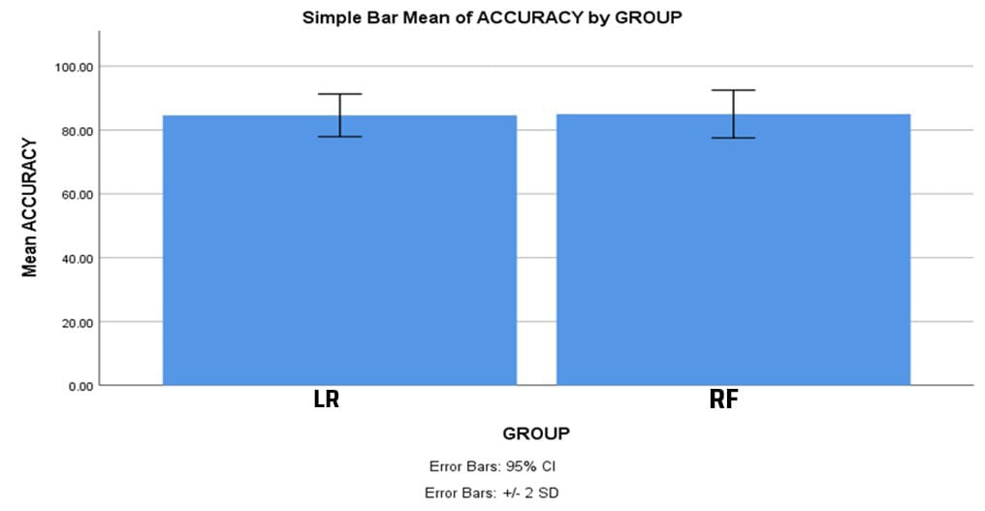
Name: B. Hemanth Chowdary Register Number: 192211206
Guided by Dr. Nelson Kennedy Babu C
Ms. Poorani.S
Guided by Dr. Mary Valantina. G
Insurance Cold Calling Optimization Using Random Forest Regression Compared with
Logistic Regression for Improved Accuracy
INTRODUCTION
The primary aim of this research is to optimize the cold-calling process for insurance companies, focusing on improving efficiency, reducing resource consumption, and enhancing overall productivity. By refining cold-calling strategies, insurance companies can more effectively attract new customers and maximize profits
To identify factors like call timing, audience demographics, and communication skills that affect cold-calling success and to evaluate the effectiveness of various machine learning techniques, such as Random Forest Regression and Logistic regression, in streamlining marketing and sales initiatives for insurance companies
Use machine learning algorithms, such as Random Forest Regression and Logistic regression, to analyze and optimize cold-calling strategies
Enhanced sales outcomes for insurance companies, with higher conversion rates and increased customer satisfaction, resulting from more targeted and data-driven cold-calling methods
Fig 1. General Cold Calling statistics
MATERIALS AND METHODS
Import dataset and required libraries
Pre-Process data to handle missing values
Random Forest Regression
Split dataset into Training(75%) and Test Set(25%)
Implement algorithms
Logistic regression
Data Collection
Random Forest Regression algorithm achieves higher accuracy
Perform Comparison evaluation of the results obtained for each classifier using IBM SPSS V25
Process of evaluating and Optimizing Insurance Cold Calling
RESULTS
Table 1. The Mean Accuracy of the Random Forest Regression algorithm and Logistic regression
Groups |  | N | Mean | STD. Deviation | STD. Error Mean
Accuracy | Random Forest Regression | 10 | 85.4000 | 3.74166 | 1.18322
 | Logistic Regression | 10 | 84.0000 | 3.06232 | 0.96839
The figure indicates the mean Accuracy of the Random forest regression which is greater than the Logistic regression algorithm. X axis is Random forest regression vs Logistic regression, Y axis is Mean Accuracy. Error bar is +/-2 SD
Fig 2. Mean Accuracy Graph
DISCUSSION AND CONCLUSION
Random Forest Regression outperformed Logistic Regression in predicting insurance cold-call outcomes, achieving a higher average accuracy of 85.4% compared to 84.0%
Statistical analysis revealed differences in standard deviation and mean standard error between the two algorithms, indicating variability in predictions and model stability
Independent variable statistical calculation showed a significance level of 0.273 in comparing the accuracy rates between Random Forest Regression and Logistic Regression
The superiority of Random Forest Regression is attributed to its effectiveness in optimizing cold-calling procedures, aligning with the procedural nature of the cold calling domain
Logistic Regression, while offering interpretability, may struggle with capturing complex temporal relationships in insurance cold calling data
Acknowledgment of study limitations, including its focus on a specific dataset and potential variation in algorithm performance across different data sources or insurance firms
BIBLIOGRAPHY
Anderson, Raymond. 2022. The Credit Scoring Toolkit: Theory and Practice for Retail Credit Risk Management and Decision Automation. Oxford University Press. DOI: 10.1093//9780199226405.001.000
Brownlee, Jason. 2021. Optimization for Machine Learning. Machine Learning Mastery. DOI: 10.1017/CBO9781316402276
Denuit, Michel, Donatien Hainaut, and Julien Trufin. 2022. Effective Statistical Learning Methods for Actuaries I: GLMs and Extensions. Springer Nature
DOI: 10.1007/978-3-030-25827-6
Géron, Aurélien. 2021. Hands-On Machine Learning with Scikit-Learn, Keras, and TensorFlow: Concepts, Tools, and Techniques to Build Intelligent Systems. “O’Reilly Media, Inc.”
Kumar, Sandeep, Anuj Sharma, Navneet Kaur, Lokesh Pawar, and Rohit Bajaj. 2024. Optimized Predictive Models in Health Care Using Machine Learning. John Wiley & Sons. 10.1002/9781394175376.ch11

